Slide 2
Wiltshire College Movie Reviews
ABOUT
FEATURES
GALLERY
CONTACT

Slide 3
ABOUT
In our new movie review app, we write the reviews of the latest blockbuster hits both in the cinema and on DVD. We can write our own opinion on what we think the movie is about, or you can write your own review on your favourite movie that you’ve seen recently.
HOME

Slide 4
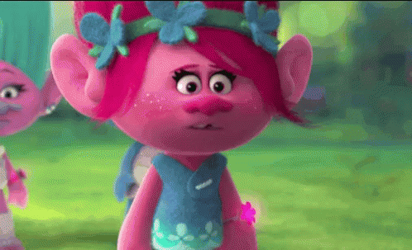
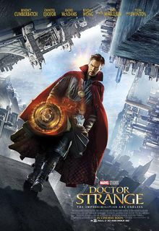
FEATURES
TROLLS:
‘Best animated movie we’ve ever seen since ‘The Lion King’.
Doctor Strange:
‘Two stunning, psychedelic hours.’
James Dyer - Empire
HOME

Slide 5
CONTACT
Phone Number: 01225 350035
Address: Wiltshire College, College Rd, Trowbridge BA14 0ES
HOME

