Slide 1
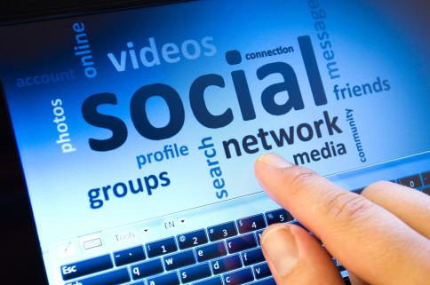
Interactive Media Technology

Slide 2
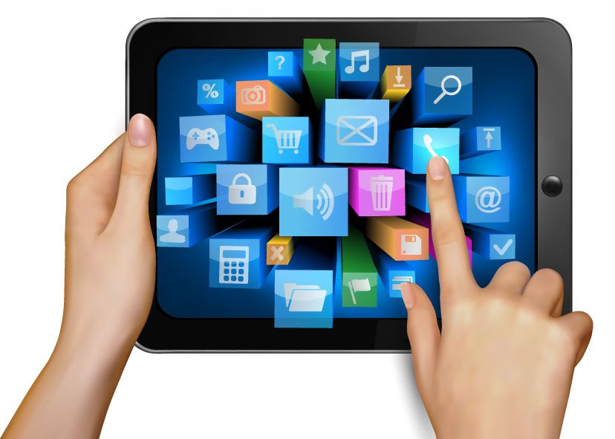
What does interactive mean? Interactive means allowing a two-way flow of information between a computer and a computer-user; responding to a user’s input. How can technology be interactive? It can be interactive by pressing buttons on a device (iPhone, iPad etc.) List as many examples of interactive media technologies as you can think of in 2 minutes; Computer games TV programmes Video Games Apps Tablets Mobile phones

Slide 3
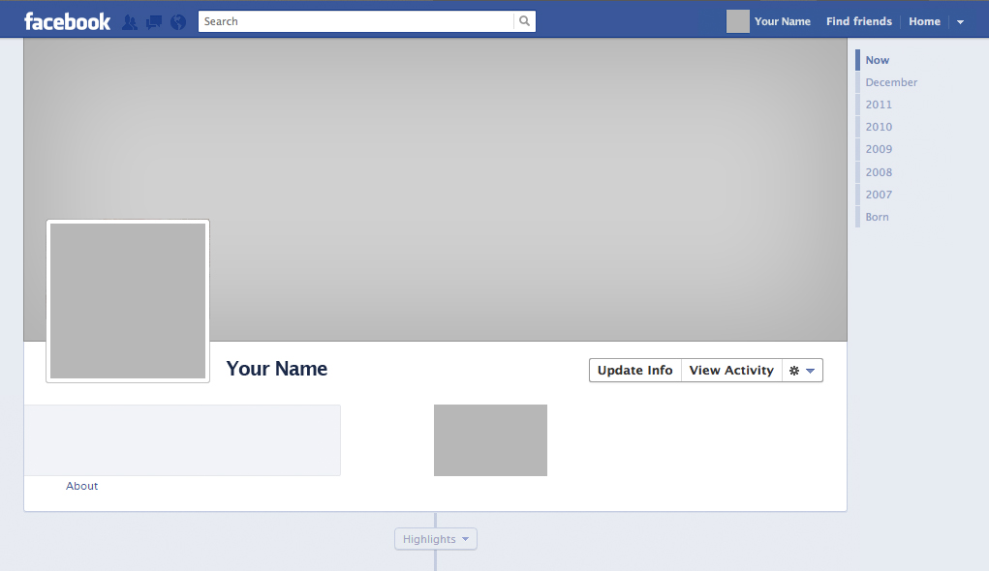
Social Media Social media websites are one of the most common interactive technologies we use these days; If you think about Facebook think about the different ways we can interact using this one website. List the examples here; Do live videos that can interest you. Upload pictures (not offensive). Read messages from your friends. Make friends on Facebook.

Slide 4
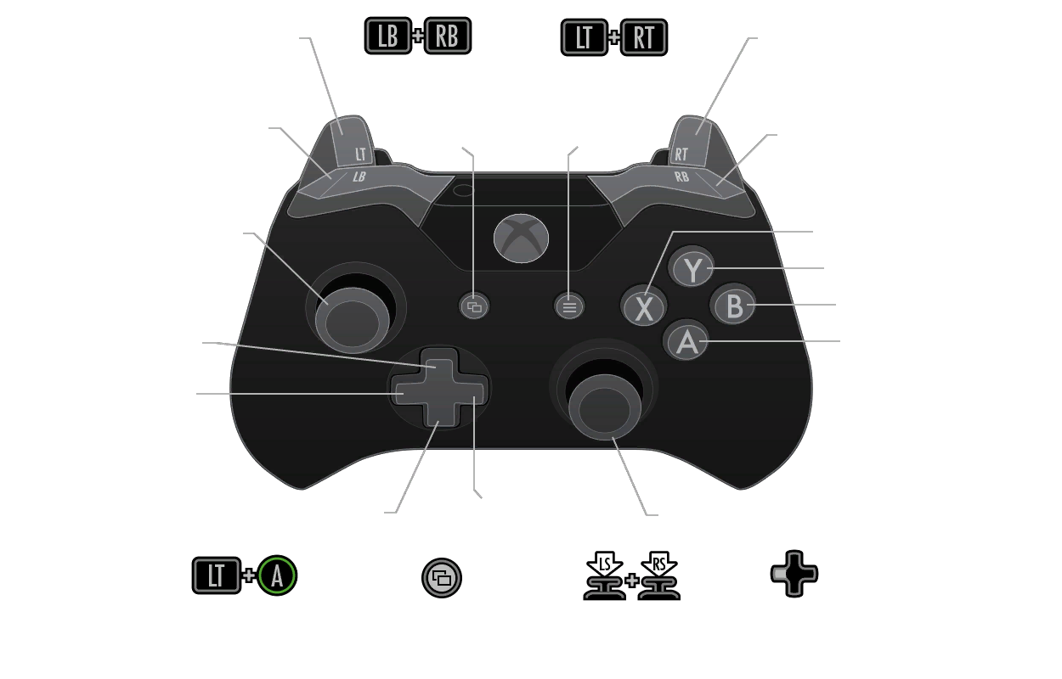
Games Video games are also one of the common examples of Interactive Media as the players make use of the joystick/controller/finger to interactively respond to the actions and changes taking place on the game screen generated by the game application, which in turn reacts to the response of the players through the joystick/controller. Think of an example of a game you know/ play and illustrate the control scheme Just Dance 2016 I like playing that game, because it helps me become a better dancer like in the dancing movies and music videos. The control scheme is easy to use. I play it on the Wii. When I start danced to a song I like, I use the remote to throw my hands up in the air and following the dancer’s moves. I try doing it on easy mode. When I dance, I don’t use the buttons. It’s a button-free game.

Slide 5
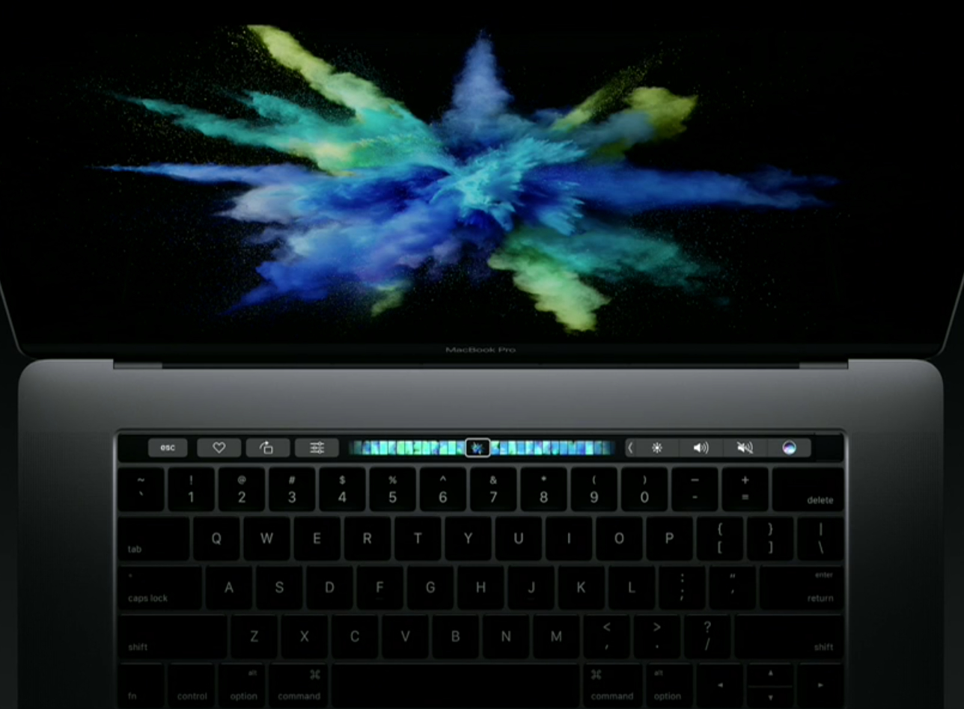
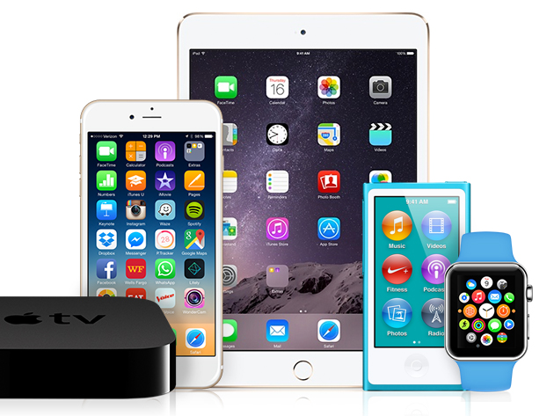
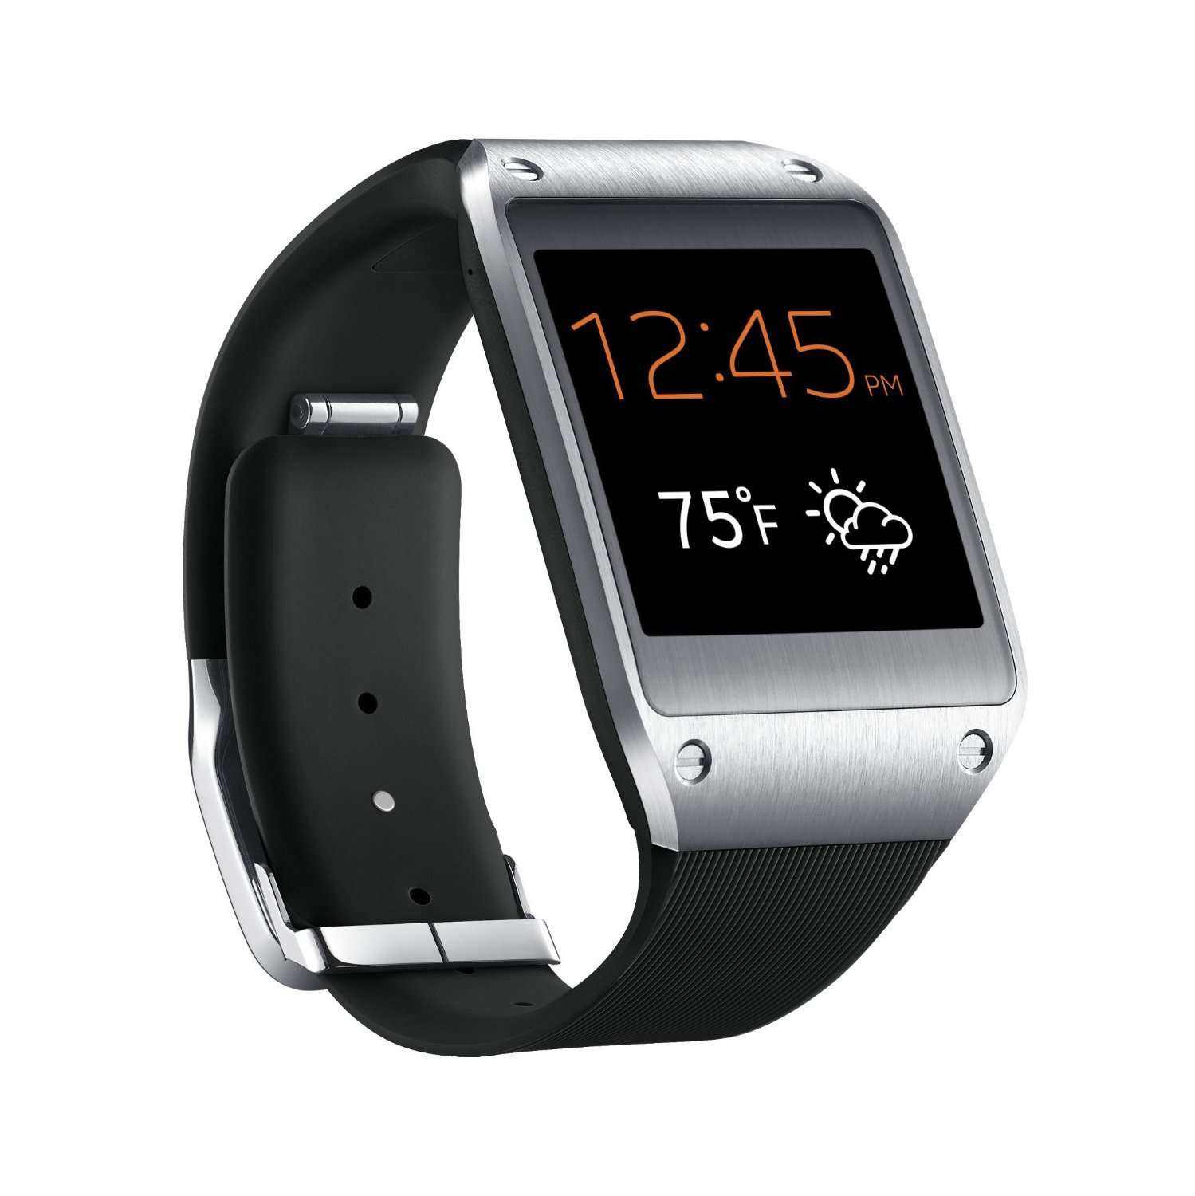
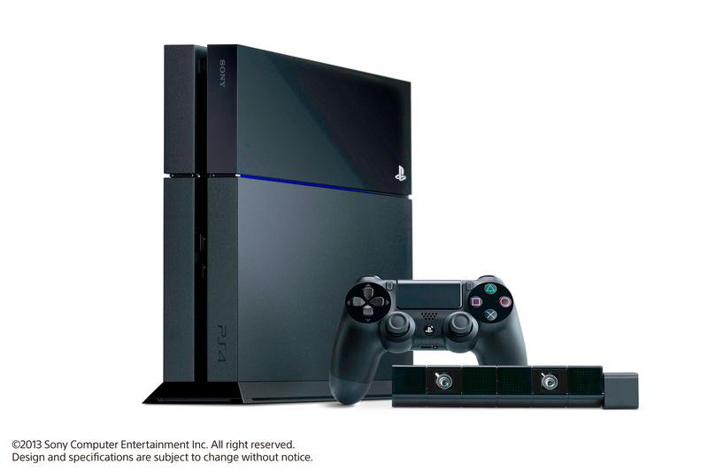
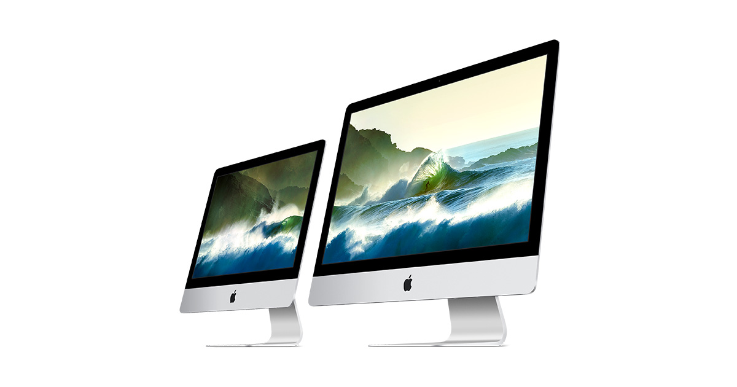
Use this page as a canvas to produce a collage of images to represent the types of interactive media technology you use in your lives

