Slide 1
Level 1
Work Experience 2016 – 17
MUGA Design

Slide 2
BRIEF
Wiltshire College has approached you to help transform the Trowbridge campus.
You have been asked to present a proposal to convert what is currently waste ground at the back of the campus into an area that enhances the campus.
You have been given an open budget by the college Principal to come up with a fun and exciting use of the space.
As part of your design proposal you are asked to produce the following;
A mind map detailing possible content for the area
A mood board to reflect the visual themes you have for the space
A design floor plan indicating position and content placing of your designs.

Slide 3
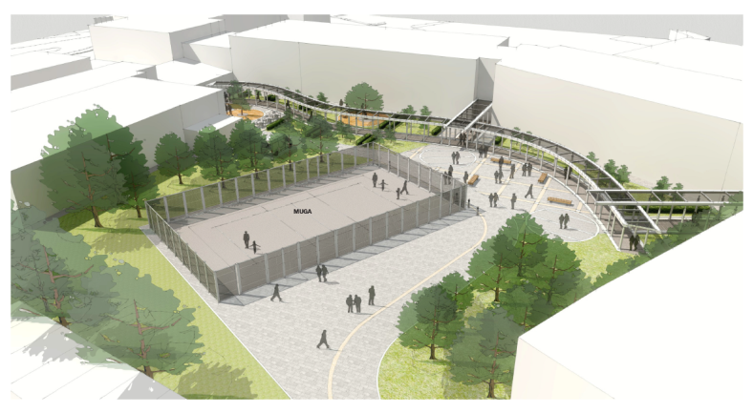
Here is an artists impression of a completed design for the MUGA area.
Use this as inspiration for your own designs.

Slide 4
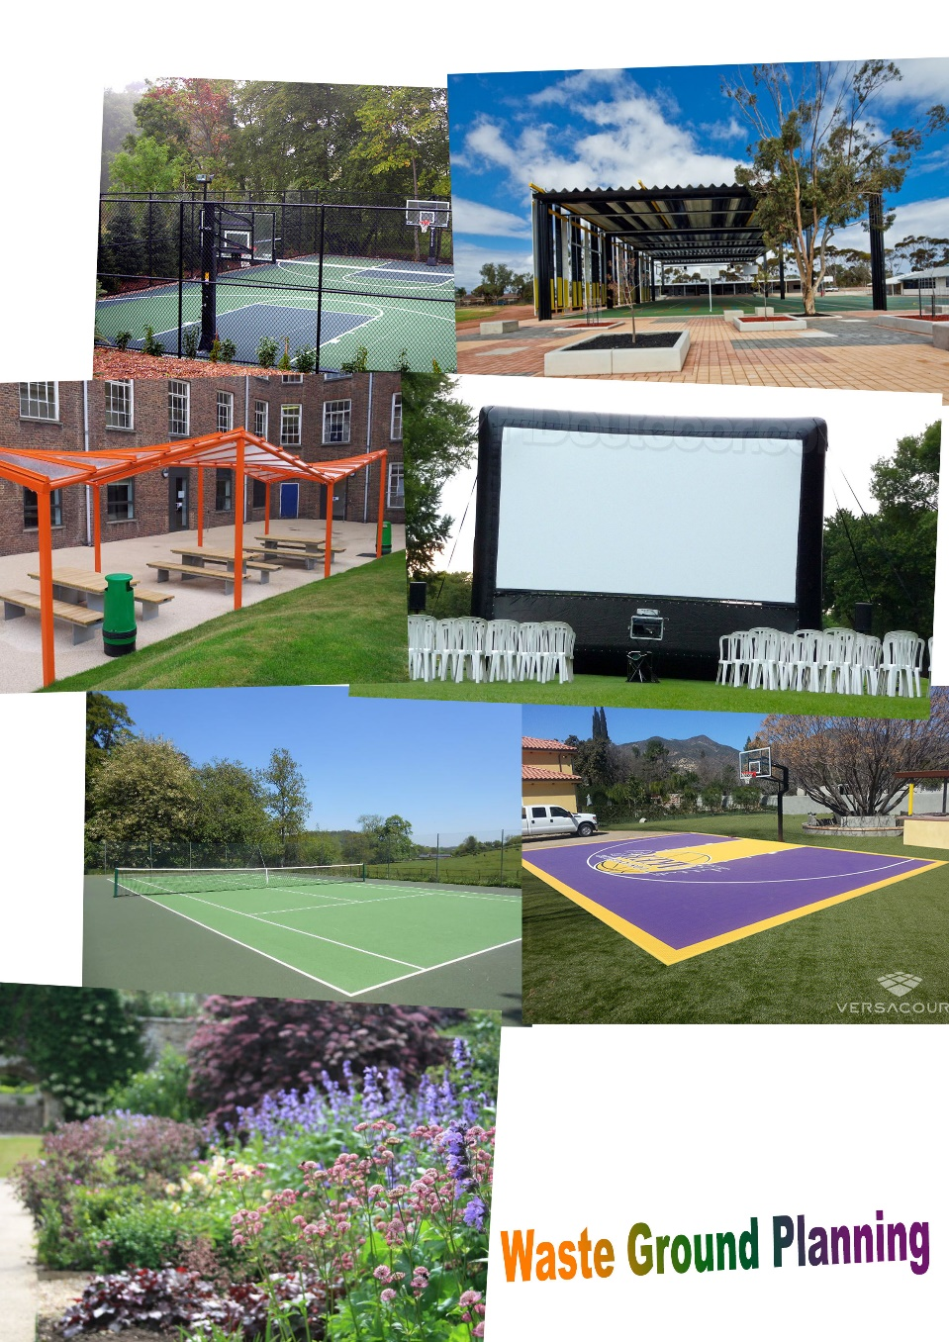
Mood Board
Mood Boards should be placed here to convey the type of area you intend to design for the college as part of the MUGA area.
Consider colour schemes, textures and images that will represent what you want this space to reflect for yourself and fellow learners

Slide 5
Mind Map
Walled garden
Map out as many ideas as you can think of for the area to include. What sort of activities are appropriate for the learners attending Wiltshire College Trowbridge?
Extended play-thingy area
MUGA AREA DESIGN
Eating area
Fenced basketball court
Extra shelter area

Slide 6
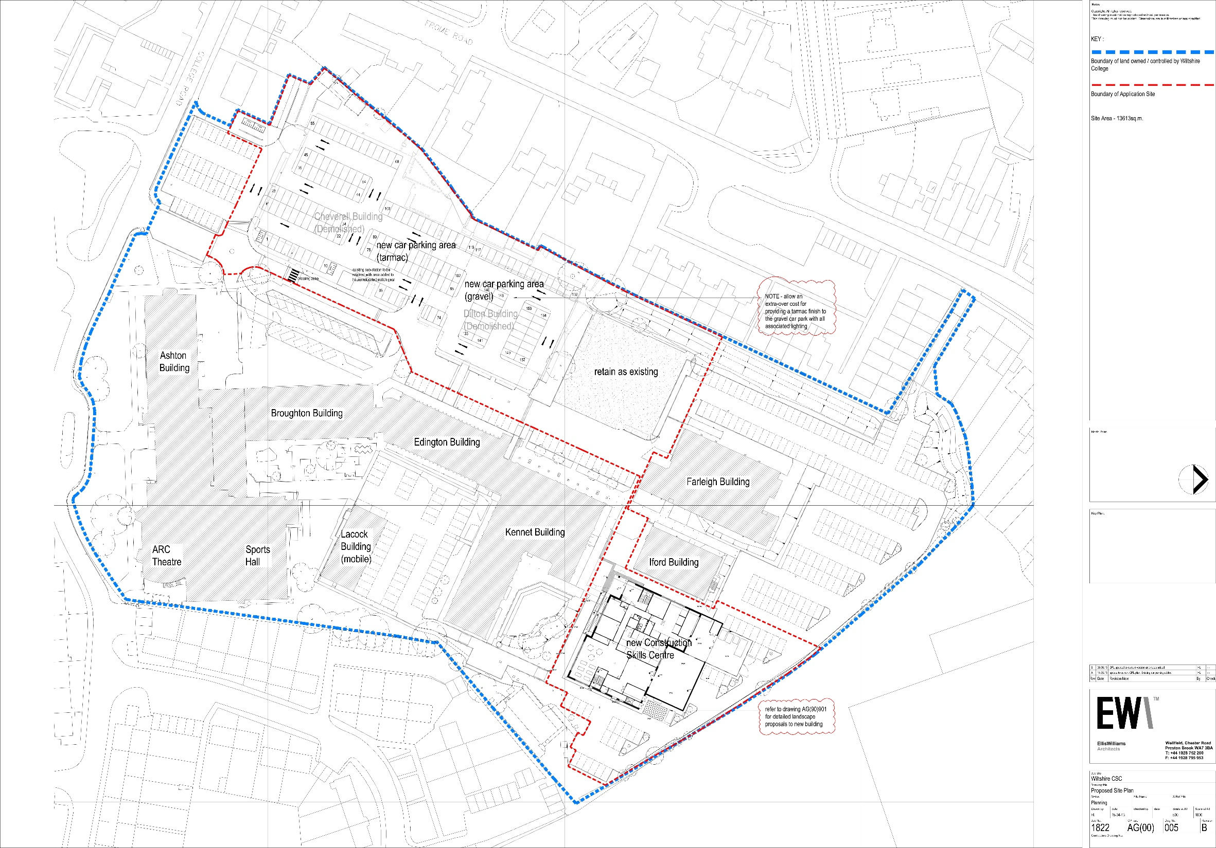
This is the overall floor plan of the Wiltshire College, Trowbridge campus to give you an idea of the scale of the area you are required to design

Slide 7
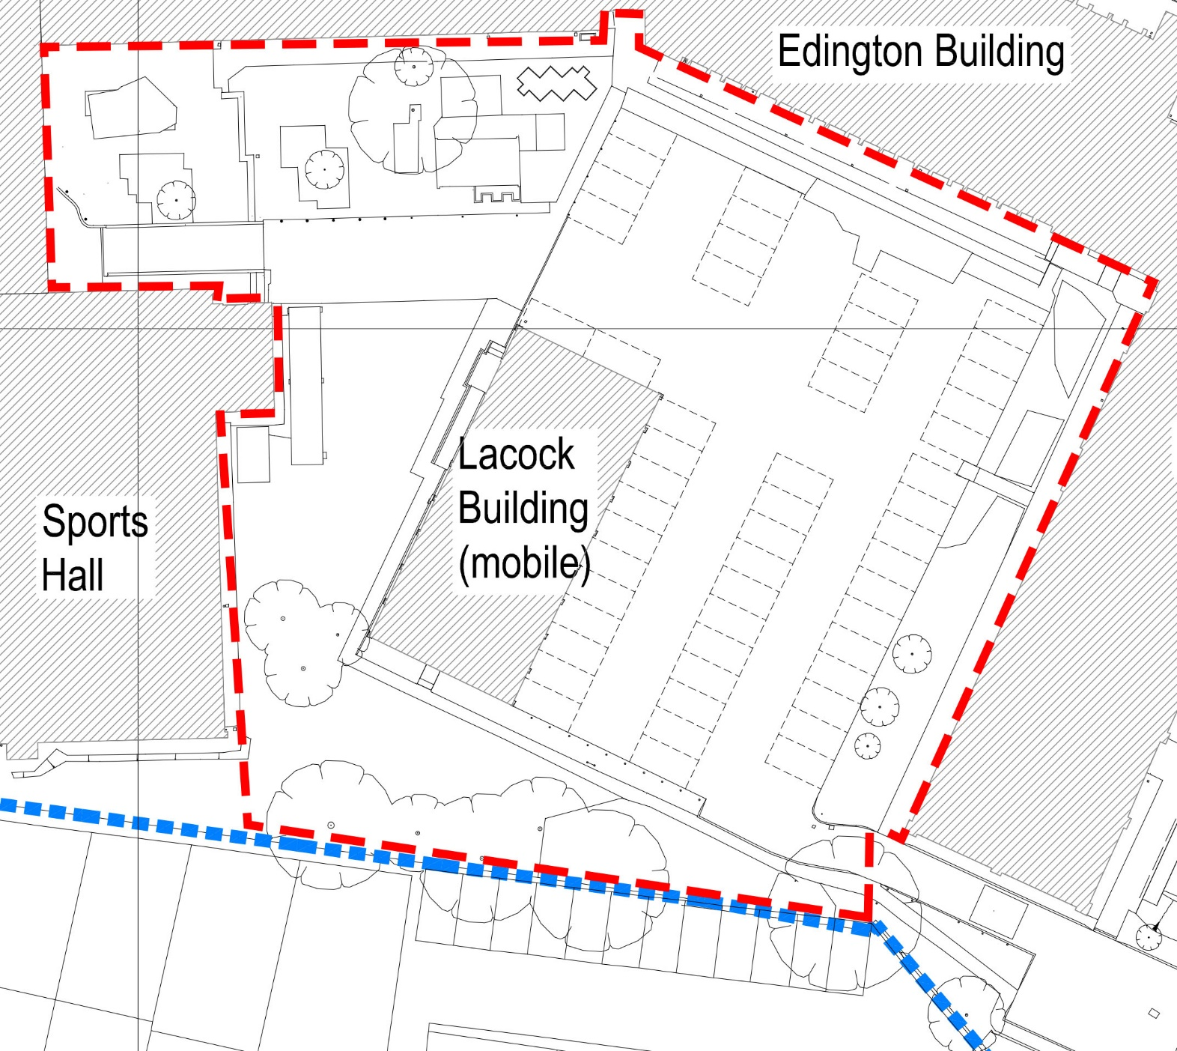
Fenced tennis court
Extra shelter area
This is the floor plan of the specific area for the MUGA as indicated within the red broken line

Slide 8
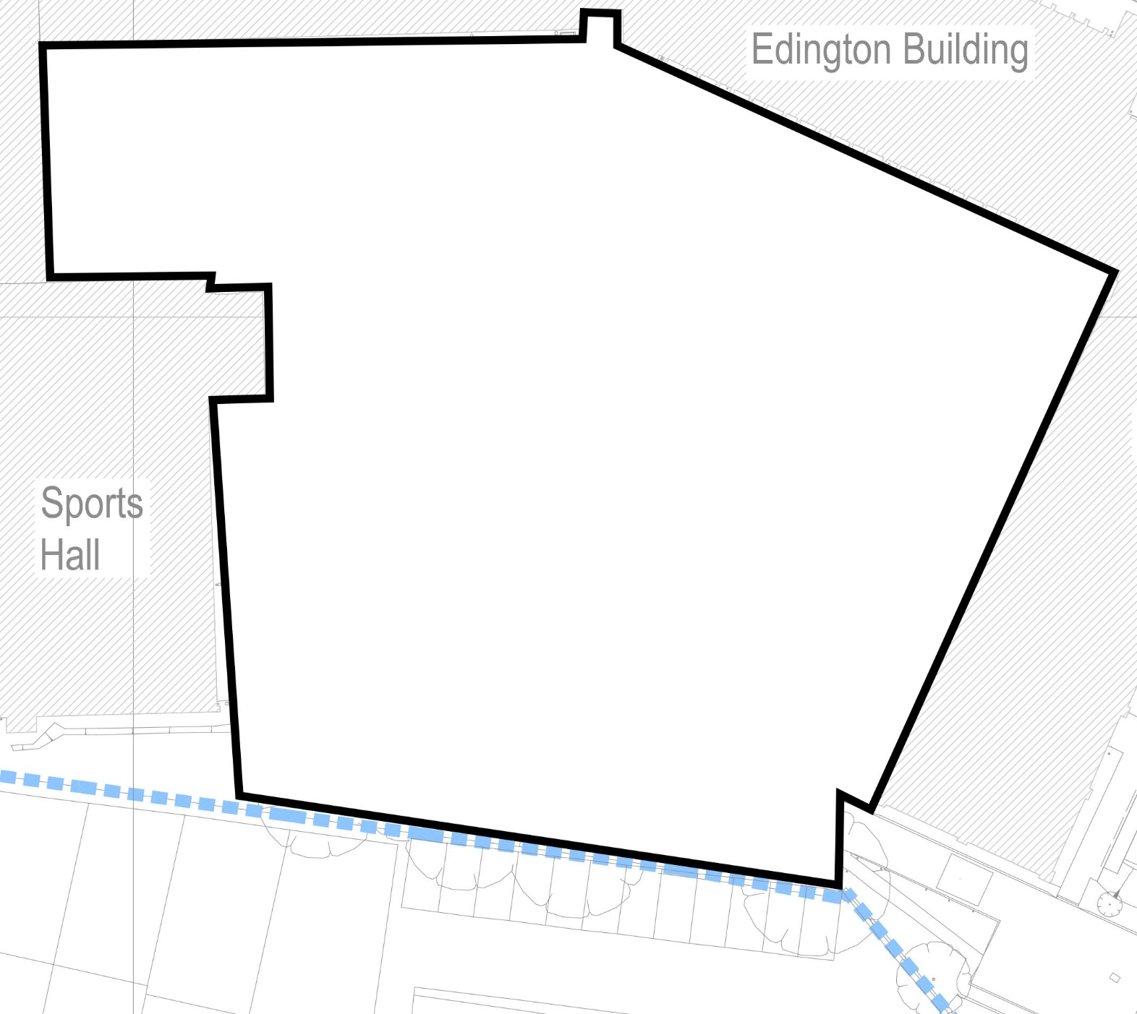
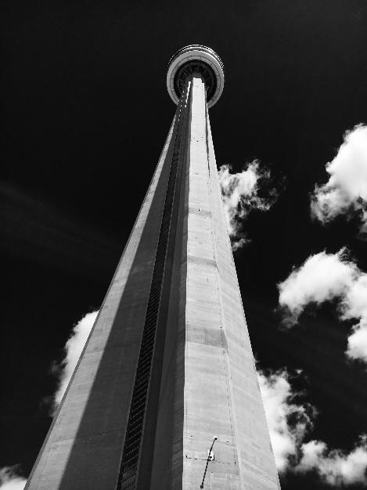
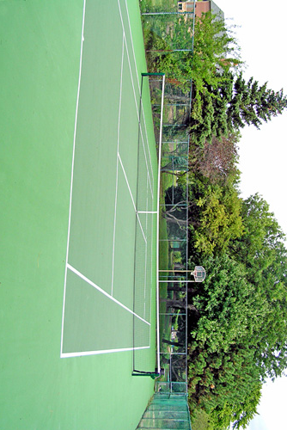
Sketch or place digital images here to indicate the position and content of your designs.
It won’t be THAT big. It’s just an example for a gaming sort of room.

