Slide 1
My Clayfighter characters
SEB SANDFORD

Slide 2
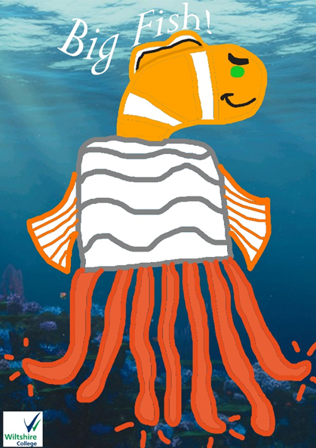
Big Fish!
I like the design for Big Fish!, because I like the way his tentacles make him punch someone in the face, and the SUPER SWIM MODE thing blew me away with that idea, because all superheroes have powers. So why not do a Clayfighter character with stronger powers than anyone else in the game.
Big Fish! is going to appeal to under 12s, because I like the way he uses his powers, and he’s a superhero fighting for good.

Slide 3
BIG FISH!
Still stance – The character walks over to its enemy and is ready to fight. His head is nodding a little fast. He’s standing still. He moves his arms and fins a little fast.
Walking stance – All four tentacles make my character walk. His tentacles push him to make him walk fast.
Low attack – The tentacles will knock off the enemy’s legs like a whip.
High attack – Big Fish uses his fins to punch the enemy in the face. His tentacles will stretch out and kick the enemy’s stomach and make it fall to the ground.
Special attack – Big Fish makes a super swim. He starts to glow before he attacks with the super swim.
Taunt – Big Fish wins the match. He’s better than anyone else in the game.
My designs allow my attacks. They will work. They are 89% effective when considering the above. The taunt is 11% non-effective, because I couldn’t come up with anything.

Slide 4
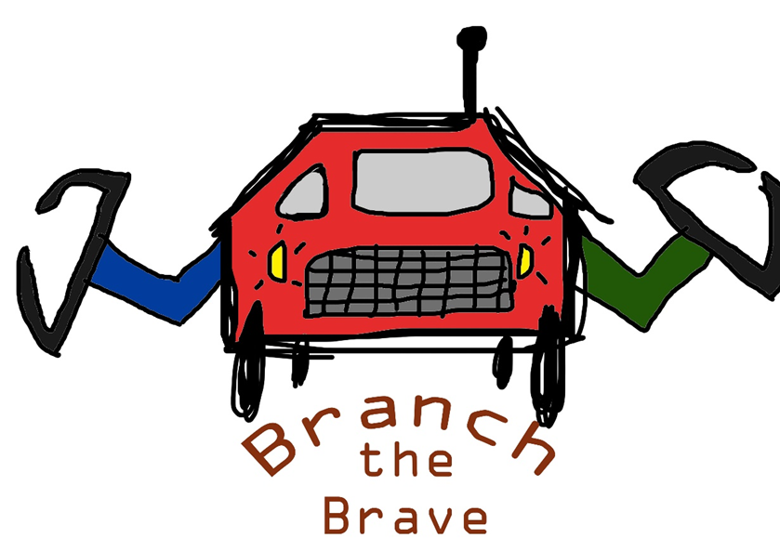
Branch the Brave
I like the design for Branch the Brave, because he inspired me to create a Clayfighter character made out of car + truck parts.
Branch is going to appeal to under 12s, because he’s made to fight bad guys made out of metal and, you guessed it, another superhero fighting for good.

Slide 5
Branch the Brave
Still stance – He’s walks on over to the enemy and is ready to fight. He’s moving his claws around a little bit and clinking them until he’s ready.
Walking stance – His wheels make Branch move and drive slowly.
Low attack – One of his wheels are let loose and it lets the enemy slip and fall down to the ground.
High attack – His claws make him grab the enemy and spin him/her around, throw them up in the air until it falls and feels dizzy
Special attack – He has super speed, and he drives straight into the enemy and punches it with his claw.
Taunt – Branch the Brave wins the match!!! He’s the mightiest of all machines in the game.
My designs allow my attacks. They will work. They are 81% effective when considering the above. The taunt is 94% effective, because it was the best I could come up with.

Slide 6
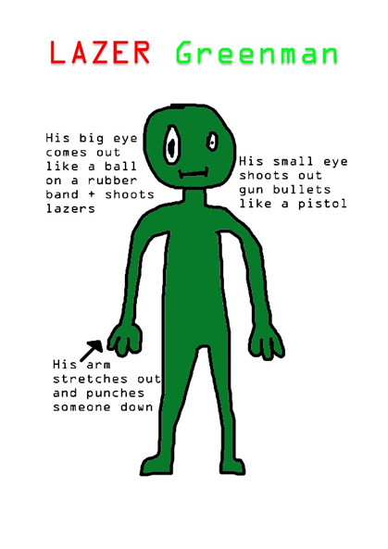
Lazer greenman
I don’t like the design for Lazer Greenman, because I couldn’t come up with more information or characteristics to add to him.
It wasn’t a hard decision and was easy to not like him, because Lazer doesn’t appeal to me.
Lazer Greenman, although I disagree, is NOT going to appeal to under 12s, because the gun bullets are going to offend children under that age. The same thing goes for the laser shooting.
I took the punching idea from Big Fish!, and I copied it to make Lazer better than him. I felt like it was a bad idea to take someone else’s powers and making it 30 times better.

Slide 7
What I’m keeping…
I’m keeping Big Fish!, and Branch the Brave, because they inspire me to create them, and their powers are better than the ones belonging to superheroes.
They both have sound effects. Big Fish! has the Chinese warrior sound effects, and Branch the Brave has the monster truck sound effects and says ‘Drop &give me twenty!!!’
This hits the brief more, because it’s got
more interesting detail of movement. It also
tells me that Big Fish’s moves are child
Friendly and the same thing goes for
Branch.

Slide 8
Swot Analysis

Slide 9
The End…

