Slide 1
Regulatory Bodies
Roles and Responsibilities

Slide 2
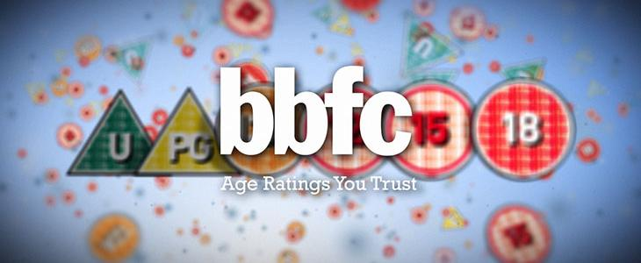
BBFC
The British Board of Film Classification is an independent, non-governmental body which has classified cinema films since it was set up in 1912 and videos/ DVDs since the Video Recordings Act was passed in 1984.
Working as an independent, self-financing and not-for-profit media content regulator, the BBFC operates classification and labelling systems in the UK.
The BBFC aims to:
protect the public, and especially children, from content which might raise harm or risks
empower the public, especially parents, to make informed viewing choices
recognise and respect adult freedom of choice within the law
respond to and reflect changing social attitudes towards media content through proactive public consultation and research
provide an effective service to enforcement agencies

Slide 3
ASA
The Advertising Standards Authority is the UK’s independent regulator of advertising across all media.
They apply the Advertising Codes, which are written by the Committees of Advertising Practice.
Their work includes acting on complaints and proactively checking the media to take action against misleading, harmful or offensive advertisements.
As the UK’s independent regulator for advertising across all media, their work includes acting on complaints and proactively checking the media to take action against misleading, harmful or offensive advertisements, sales promotions and direct marketing.

Slide 4
PEGI
The Pan-European Game Information (PEGI) age rating system was established to help European parents make informed decisions on buying computer games.
The system is supported by the major console manufacturers, including Sony, Microsoft and Nintendo, as well as by publishers and developers of interactive games throughout Europe.

Slide 5
IPSO
The Independent Press Standards Organisation (IPSO) is the independent regulator of the newspaper and magazine industry. They exist to promote and uphold the highest professional standards of journalism in the UK, and to support members of the public in seeking redress where they believe that the Editors' Code of Practice has been breached. They are able to consider concerns about editorial content in newspapers and magazines, and about the conduct of journalists.
They ensure issues and rules around the following areas of the editors code are followed…
Accuracy
Opportunity to reply
Privacy
Harrasment
Intrusion into grief or shock
Children
Hospitals
Reporting of crime
Clandestine devices or subterfuge
Victims of sexual assault
Discrimination
Financial journalism
Confidential sources
Witness payments in criminal trials
Payment to criminals

Slide 6
OFCOM
Ofcom is the communications regulator. They regulate the TV and radio sectors, fixed line telecoms, mobiles, postal services, plus the airwaves over which wireless devices operate.
They ensure...
a wide range of high-quality television and radio programmes are provided, appealing to a range of tastes and interests;
television and radio services are provided by a range of different organisations;
people who watch television and listen to the radio are protected from harmful or offensive material;
people are protected from being treated unfairly in television and radio programmes, and from having their privacy invaded.

Slide 7
PRS
Three companies exist under the PRS for Music umbrella:
Performing Right Society Limited (PRS)
Mechanical-Copyright Protection Society Limited (MCPS)
PRS for Music Limited
PRS for Music is a collecting society which songwriters, composers and music publishers become members of in order to get paid for the use of their music. PRS for Music collects licence fees from anyone that uses music for a business benefit, and then pays royalties to music creators in the UK and around the world.

